Slide 1
Church Road Improvements
Temporary Road Closure Meeting
May 19, 2021

Slide 2

Church Road Improvements
4-lane road
Bike Lane and asphalt paths
Golf cart paths
New creek crossing
New roundabout
New roundabout

Slide 3
Church Road temporary road closure between Mary Bowie Parkway & Dormansville Boulevard (0.4 miles)
Road Closure
Box Culverts
Road Closure
Road Closure

Slide 4
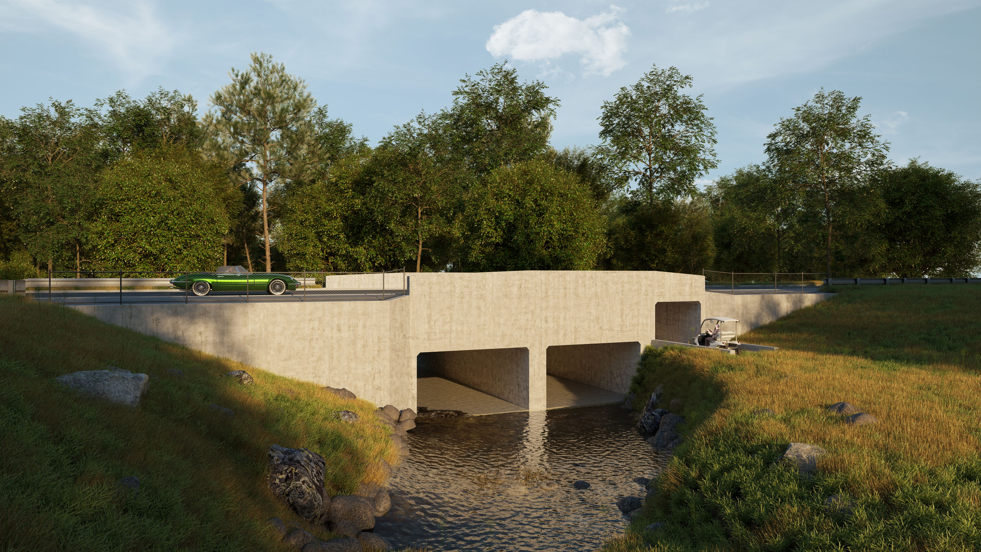
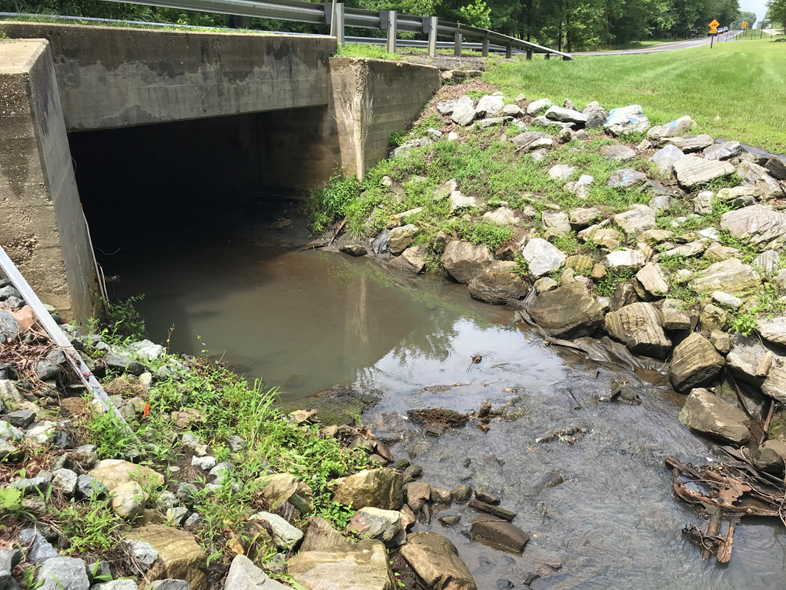
New creek crossing with integrated golf cart path

Slide 5
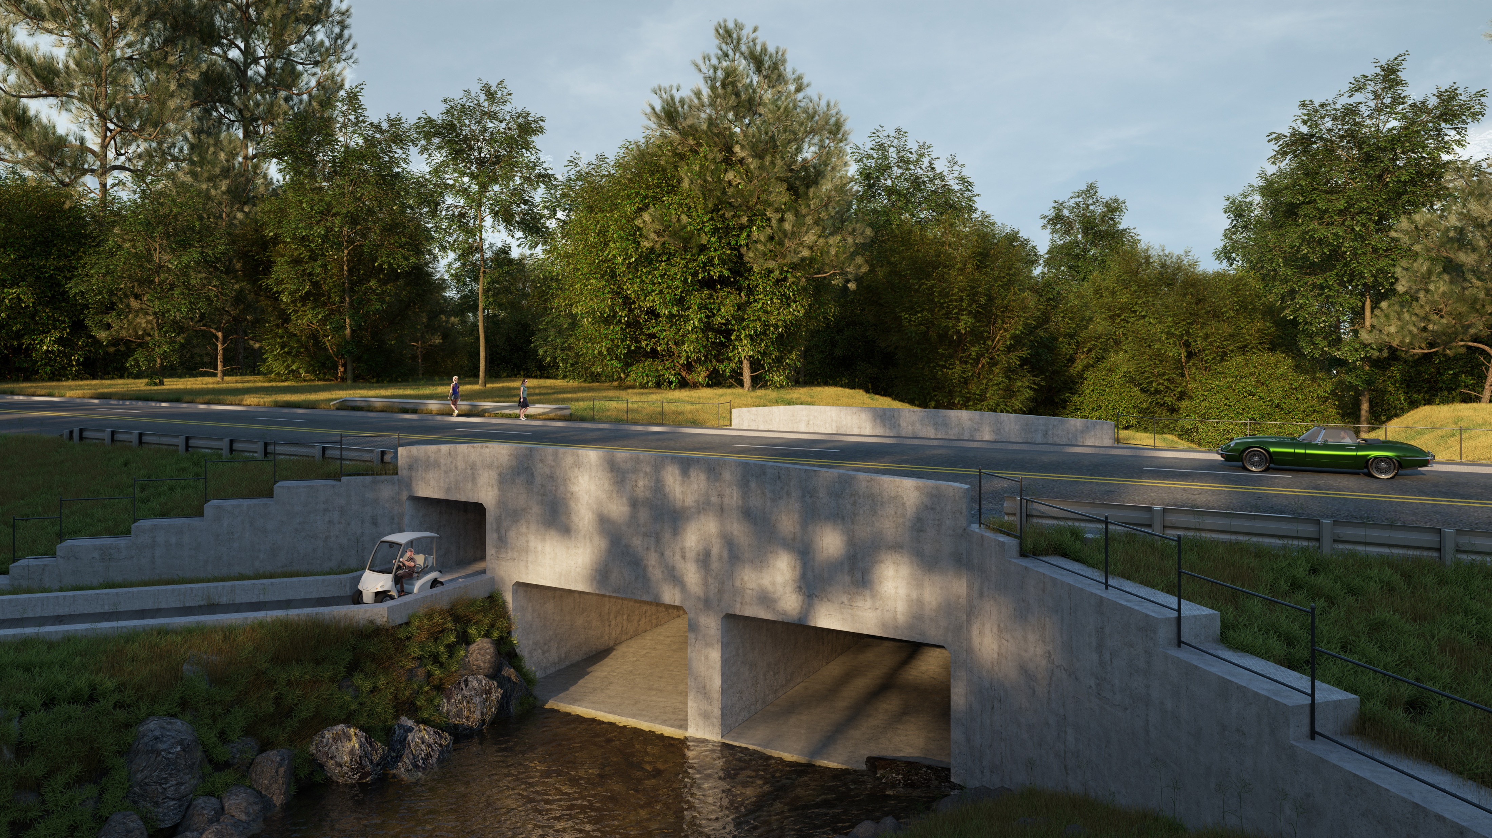
Significant safety enhancements:
Flood control, pedestrian and biking paths, golf crossing

Slide 6
Construction Phasing and Justification For Road Closure
Phasing:
  Leave the existing box culvert in place while the first of the two proposed 18’x10’ conveyance box culverts is constructed to the South.
  Divert the stream from the existing box culvert and into the newly constructed southern box culvert.
  Construct the northern 18’x10’ box culvert, 10’x8’ box culvert, and associated improvements.
There is not enough space in the existing 22-foot travel way to phase the installation of the southern box culvert and provide the minimum 10’ travel lane through the work zone.
Constructing the 18’ x 10’ precast culvert in the vicinity of a vehicular travel way would pose a significant danger to both the public and the workers.
Road closure would shorten the duration of the road improvements.

Slide 7
Church Road Detour Plan
Expected closure mid-June 2021 for approximately 7 months.

Slide 9
Questions?

